Slide 1
ONLINE FOOD ORDERING SYSTEM
Name : OM PRASAD KANDEL
Semester : 4

Slide 2
Introduction
An Online food ordering system is a web-based application that stimulates the foodies (customers) to put food orders through internet by locating their favorite restaurant or nearest one. This application is based on the PHP [ 1 ] platform.
The system typically consists of a user-friendly website or mobile application where users can explore menus, view prices, select dishes, customize orders, and make payments electronically. Customers can often create accounts to store their preferences, delivery addresses, and payment information for future orders, enhancing the convenience of the ordering process.

Slide 3
Statement of problems
The problem of online food ordering system are given below:
This process can be time-consuming, especially during peak hours, and may result in miscommunication or error in order placement .
Ordering system are not providing the detail, so costumer may get confused about the specification of the products.

Slide 4
Objectives
User can friendly and efficient.
To ensure customer satisfaction.
To Improving the communication between the client the sever.

Slide 5
Feasibility
Economic Feasibility
The development and implementation cost of the system should be reasonable in comparison to the benefits and potential revenue generation from increased customer base and higher order volumes.
Technical Feasibility
Technical feasibility should be technically implements, considering the available technology, resources, and infrastructure. It is an evaluation of the hardware and software and how it meets the needs of the proposed system.
Operational Feasibility
The system is operational feasible since the user are familiar with the technologies and hence there is no need to gear up the personnel to use the system. The system is very user friendly and easy to use

Slide 6
Requirement Analysis
5.1 Functional Requirement
The functional requirements of this online food system include:
The system shall display the food items ordered, the individual food item prices and the payment amount calculated.
The system shall allow the manager to update price for a give food item.
The system shall allow confirmation of pending orders.
5.2 Non- functional Requirement
A non-functional requirement is a requirement that specifies criteria that can be used to judge the operation of a system, rather than specific behaviors. Some of the nonfunctional requirements include:
Safety-should be safe to use.
Maintainability- easy to maintain.
Backup- provision for data backup

Slide 7
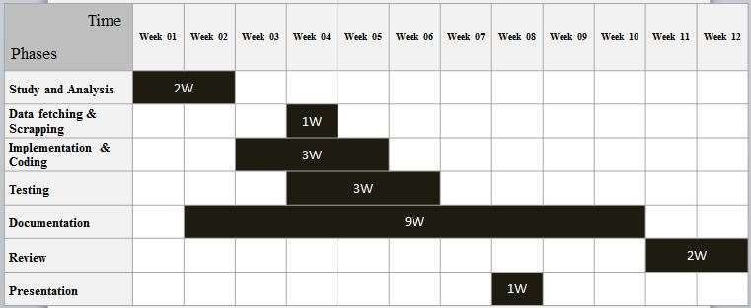
Grant chart

Slide 8
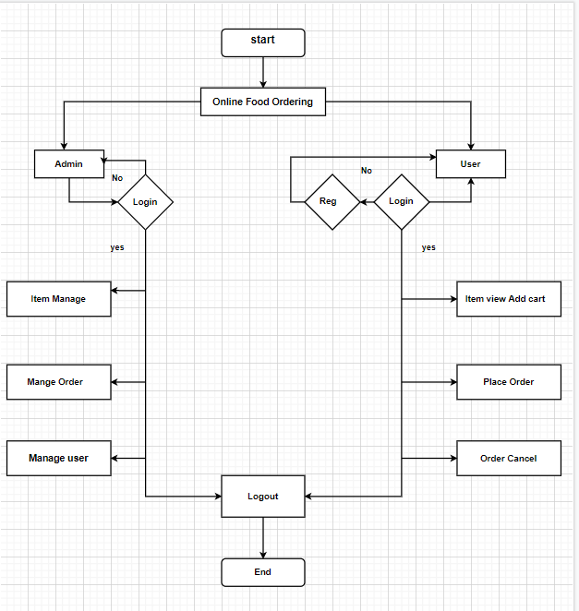
System Analysis
Flow chart

Slide 9
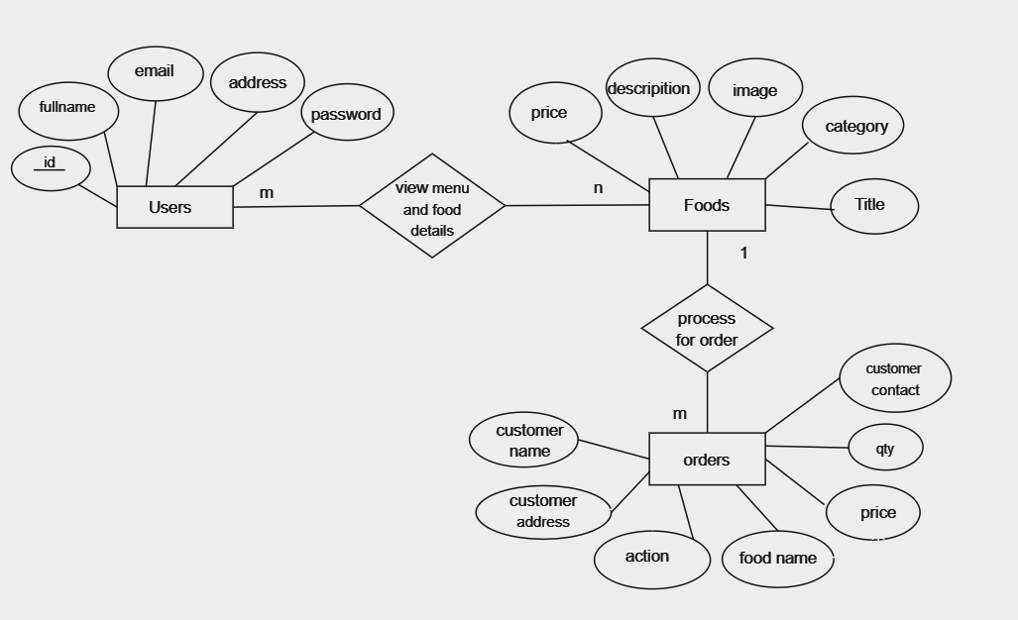
ER-daigram

Slide 10
conclusion
In conclusion, the development of an online food ordering system will greatly enhance the ordering experience for customer and improve order management process for restaurants. This project aims to create a user-friendly and efficient platform that benefits both customers and restaurant in the food industry.

Slide 11
Thank you………!!!!!

